Slide 1
secure data hiding in images using stegnography
Presented By:
Student Name : ARCHANA BALAJI
College Name & Department : PERI INSTITUTE OF TECHNOLOGY & COMPUTER SCIENCE AND ENGINEERING

Slide 2
OUTLINE
Problem Statement
Technology used
Wow factor
End users
Result
Conclusion
Git-hub Link
Future scope

Slide 3
Problem Statement
In today's digital era, data security is a major concern. Traditional encryption methods, while effective, often attract attention. Steganography offers a solution by hiding secret messages within images, making the communication unnoticeable to outsiders. This project aims to implement secure data hiding in images using Python-based steganography techniques.

Slide 4
Technology used
Programming Language:
Python
Libraries & Platforms:
OpenCV (cv2) – For image processing
OS Module – To execute system commands
String Handling – For character-to-byte conversions

Slide 5
Wow factors
Stealthy Communication: The secret message is hidden within an image, making it invisible to the naked eye.
Lightweight & Fast: Uses pixel manipulation for encryption and decryption without significantly altering the image quality.
User Authentication: Requires a password to decrypt the message, ensuring security.
Cross-Platform Compatibility: Works on different operating systems without requiring extensive setup.

Slide 6
End users
Government & Intelligence Agencies – Secure data transfer without raising suspicion.
Corporate Organizations – Confidential information exchange.
Journalists & Whistleblowers – Safe communication in restrictive environments.
General Users – Personal secure messaging and privacy protection.

Slide 7
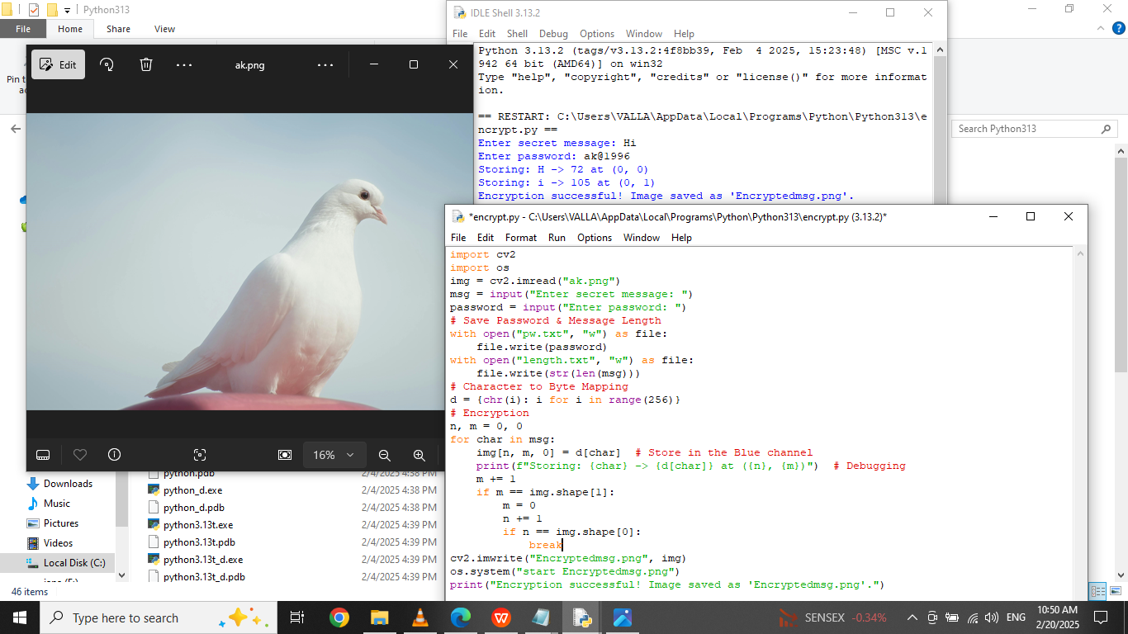
Results - original image

Slide 8
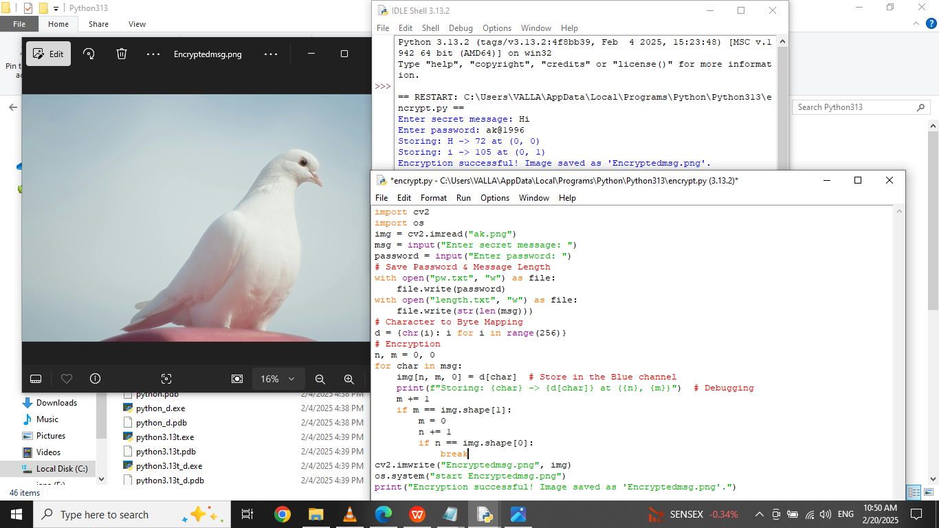
RESults - stegno / encrypted image

Slide 9
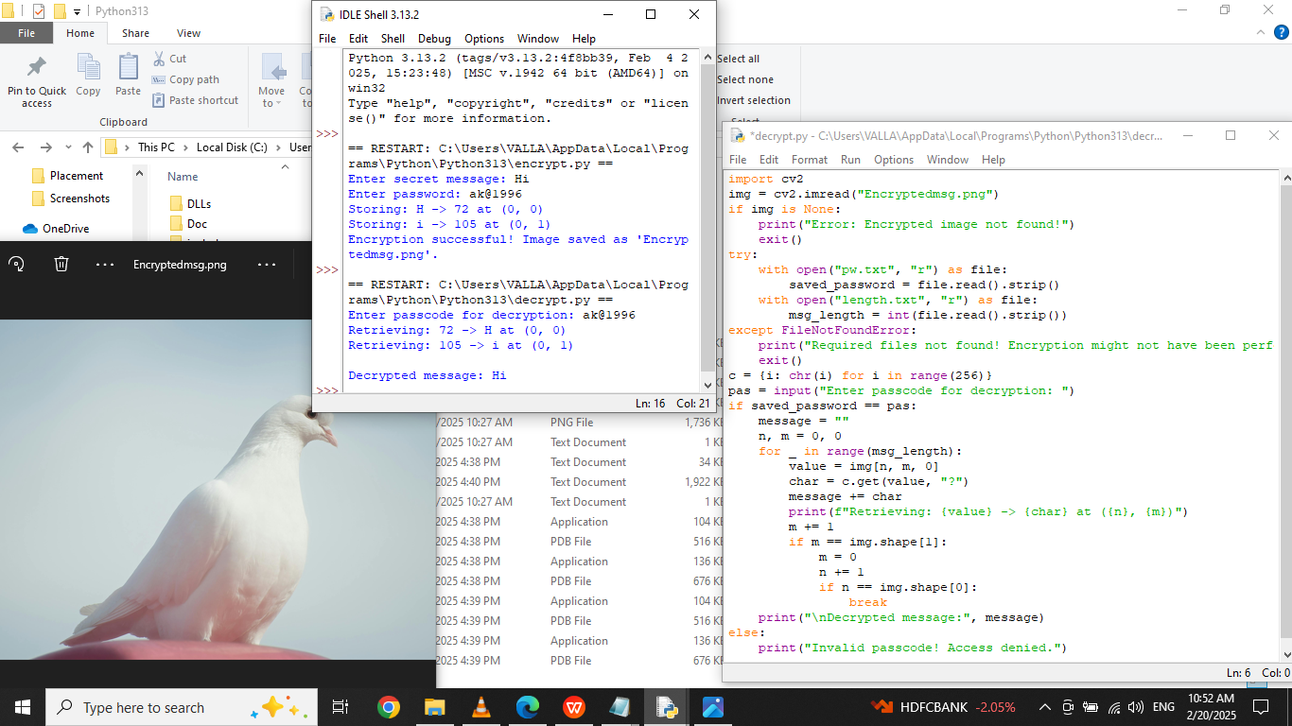
results - after decrytion

Slide 10
Conclusion
This project addresses the issue of secure data transmission by utilizing steganography. By embedding messages within images, we ensure confidential communication while minimizing suspicion. The integration of password-based decryption enhances security, making this an effective and practical approach for hidden communication.

Slide 11
GitHub Link
https://github.com/ArchanaBalaji11/AICTE-CYBER-PROJECT.git

Slide 12
Future scope
Enhanced Encryption: Implementing AES or RSA encryption before embedding the message for double-layer security.
Support for Different File Formats: Expanding beyond JPEG to PNG, BMP, and GIF.
Capacity Optimization: Improving the algorithm to hide longer messages without noticeable image distortion.
Mobile & Web Integration: Developing an app-based or web-based solution for easy accessibility.

Slide 13
THANK YOU

